Slide 1
Information Structure Challenge
Focusing on the user experience

Slide 2
The challenges
Amount of information
Tendency to report our own vision
Do you know your users?
Notes:
Amount of information
Organisations have a lot to share
Should I communicate everything I know? NO!
Where to draw the line between what I know and what they need to know?
Overcommunicate is a real danger
2) Tendency to report our own vision (Structure)
You will organise information depending on your cultural background - Organisational & personal
Totally natural but armful
The way you deal with daily tasks will be reflected
Ex. University of Aarhus
Guest Students and International Students (2 separated website, but 90% same content)
Often the results of organisational boundaries and barriers
3) Do you know your users?
In marketing: TARGET
Only way to hit the target, is to set correct parameters!
Do you know how they
Think
Feel
Worry about
Can you speak the same language?
In the current context: The effort is now on your side…

Slide 3
The IS Case

Slide 4
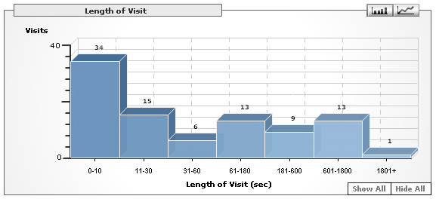
The numbers
37% leave within 10 sec
51% leave within 30 sec

Slide 5
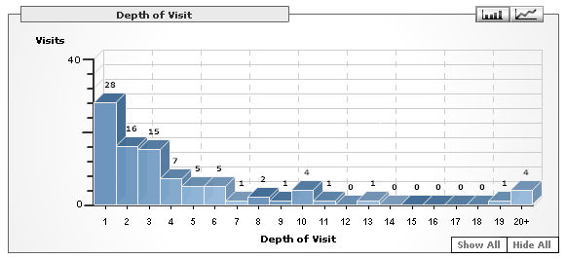
The numbers
65% of visitors leave before seeing 3 pages

Slide 6
The results
Low number of visitors
Almost no returning visitors
High level of insatisfaction
Notes:
What does that tell us?
Low number of visitors
Almost no returning visitors
High level of insatisfaction
If you leave before having seen 3 pages, you don’t have found what you were looking for.

Slide 7
Why?
Importance of words
Organisation of information
Application
Types of Accommodation
Accommodation Rates
Practical Information
Accommodation Tips
Change of accommodation
Terms and Conditions
Long-term/short-term accommodation
Contact
Notes:
Confusion all the way!
Vague and confusing terms

Slide 8
Silo thinking
Old site
        Basic info on the residence hall
        Price of the rent
        Location
        Termination notice
        When to pay the rent
        What’s included
New site

Slide 9
ECTS context
Decentralized data
Users without any cultural references
How to organise information?
Notes:
ECTS is a great step in the user oriented approch
Users without any cultural references
Country
Organisational (MAINLY!)

Slide 10
Where does it belong?
Communication
University of Ottawa
Faculty of Arts
University of Malaga
Faculty of Sciences
University of Montreal
Faculty of Arts and Sciences
UCLA
Faculty of Social Sciences
University of Aarhus
Faculty of Humanities
Notes:
Many reasons, who’s right who’s wrong? No one.
The question remains,
How to simplify the process for our users?

Slide 11
Focus on the user
Interest
  Heard of, stereotypes, personal motivations
Technical aspect
  Can I get credit transfer?
Appreciation factors
  What about the city?
  Perception of the university
  My personal comfort
Notes:
Good part of the answer lies on focusing on the user.
Let’s do the exercise of putting yourself in his position.
It all starts with an interest
Need to find equivalences. Sin qua no condition.
Is is big, small, in the center?
Focusing on the user reveals you the REAL questions you need to answer

Slide 12
How to?
Design – Attract them
Usability – Give them information
Content – Retain them
Statistics – Adjust if needed
Notes:
How to turn that into practice?
Design.
Competing in fierce grounds.
From outside, it is your resumé, your credibility
Once attracted, they need to find info easily
Once they are at the right place, content has to be well written, and answer their questions

Slide 13
Central point of service
Simplify the process
Reassure
Give Flexibility
Notes:
Finally, all this should be reflected in a central point of service.
Simplify the process
Reassure
Give Flexibility

